Slide 1
Can the American Dream really come true?
——The social factors that hinder the realization of the American Dream and how can the American Dream develop nowadays
BY：胡杨
Notes:
the topic of my presentation is can the American Dream really come true?——the social factors that hinder the realization of the American Dream and how can the American Dream develop nowadays

Slide 2
01
The social factors that hinder the realization of the American Dream
content
02
How can the American Dream develop nowadays
Notes:
My presentation includes 2 parts.First, I would like to share some of the social factors that hinder the realization of the American Dream. Second,I want to discuss maybe how can the American Dream develop nowadays.

Slide 3
The social factors that hinder the realization of the American Dream
1

Slide 4

The social factors that hinder the realization of the American Dream
“The American Dream is the belief that anyone, regardless of background, can achieve success and happiness through hard work and determination.”
Anyone?
Only need hard work?
Achieve success?
Get happiness?
“The American Dream is back”?
Notes:
I asked ChatGPT what the American Dream is .And the answer is on the ppt……
The American Dream describes the United States as a utopi.abut there is some questions……
can Trump makes the American Dream come back??

Slide 5
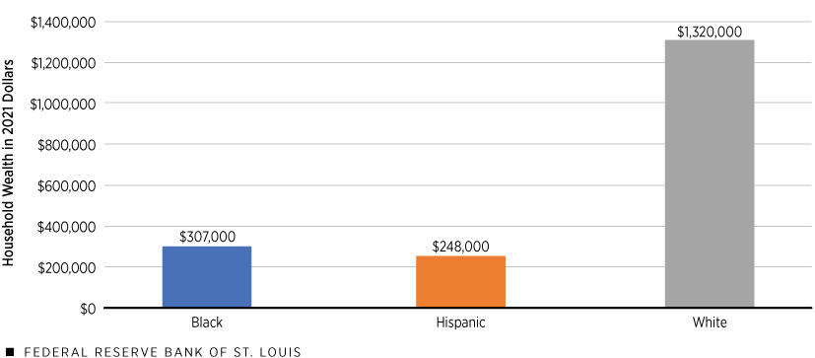
Anyone? ——Racism
Economy: The racial wealth gap remained stark, with Black families having 24 cents and Hispanic families having 23 cents for every US$1 of white family wealth, and has changed very little over the last 50 years.
Human Rights: Black Americans are three times more likely to be killed by police and 4.5 times more likely to be incarcerated than whites. Yet, of the more than 1,000 police killings each year, only 1% of officers are prosecuted.
Notes:
not anyone can reach their dreams. Racial discrimination in the United States is still serious.
Economically, from the Human Rights Watch 2024, the report shows that The racial wealth gap remained stark, with Black families having 24 cents and Hispanic families having 23 cents for every US$1 of white family wealth, and has changed very little over the last 50 years. Numerous studies have shown that drastic economic intervention, including reparations in a variety of forms, is needed to address this gap as well as continuing racial disparities in access to adequate health, nutrition, education, employment, and housing, among other things.
(种族财富差距仍十分严重，白人家户每拥有一美元，黑人家户拥有24分，西语裔家户拥有23分，而且过去50年来改变不大。众多研究显示，需要采取激烈的经济介入，包括各种形式的赔偿，才能解决这一差距以及在获得适足健康、营养、教育、就业和住房等各方面的长期种族差距。)
and the UN news shows that black Americans are three times more likely than whites to be killed by police and 4.5 times more likely to be incarcerated(/ɪnˈkɑːrsəreɪtɪd/). Yet, of the more than 1,000 police killings each year, only 1% of officers are prosecuted.(/'prɔsikju:tid/)
(美国黑人被警察杀害的几率是白人的3倍，被监禁的几率是白人的4.5倍。然而，在每年1000多起警察杀人案件中，只有1%的警察被起诉。)
With no money, no health, and even with the life threat, it is impossible for such people to reach their American Dream.

Slide 6
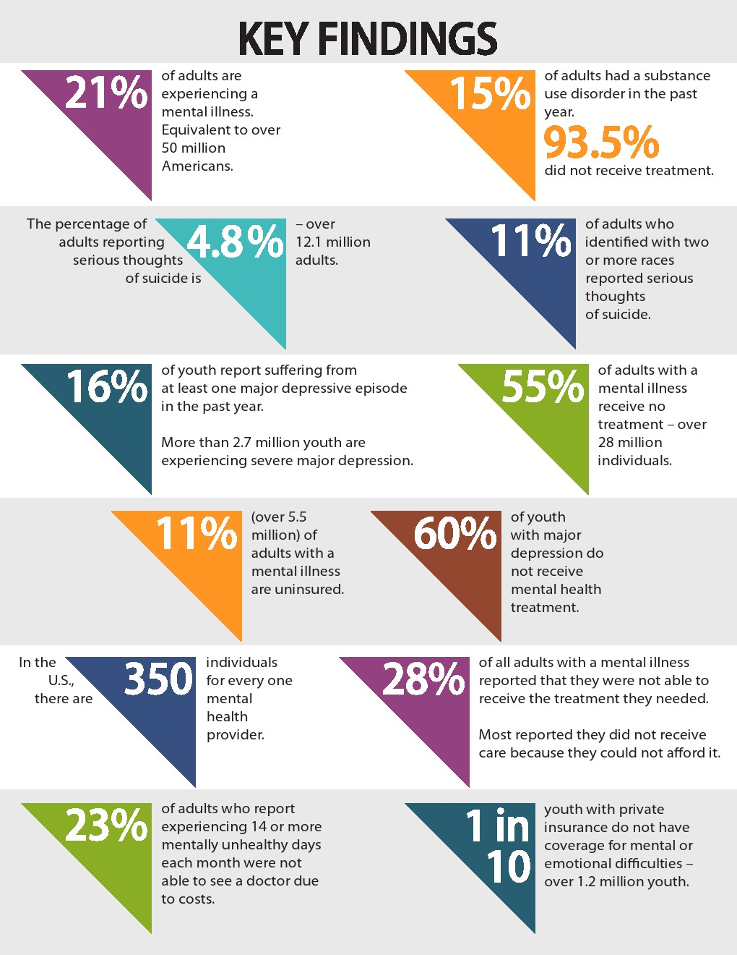
Achieve happiness? ——Mental health problems
Numerous patients
01
21% of adults are experiencing a mental illness.Equivalent to over 50 million Americans.
Poor access to treatment
02
55% of adults with a mental illness receive not treatment —over 28 million in dividuals.
In the U.S. there are 350 individuals for every one mental health provider.
03
High treatment costs
28% of all adults with a mental ilness reported that they were not able to receive the treatment they needed. Most reported they did not receive care because they could not afford it.
Notes:
can anyone achieve happiness through hard work? not really the mental health problems in American is increasingly severe.
Mental Health America(MHA) have released the state of mental health in America 2023. The report has some striking findings——as I show you on the right. It shows that the current state of mental health problems in America has 3 characteristics——numerous patients, poor access to treatment, High treatment costs.

Slide 7
Other pronlems
Access to Quality Education
Schools in low-income areas often lack resources compared to those in affluent neighborhoods.
Economic Inequality
Top 1% of earners hold a disproportionate amount of wealth; median household income stagnation.
Other problems
Many other problems
……
Environmental Challenges
Natural disasters displacing communities and increasing insurance costs.
Notes:
there are also many other problems, such as the economic inequality, the environmental challenges, the access to quality education, and so on.
Due to time constraints, we will not elaborate here. (/ɪˈlæbərət/)

Slide 8
How can the American Dream develop nowadays
2
Notes:
The American Dream seemed to be impossible
so……

Slide 9
How can the American Dream develop nowadays
Maybe make it more smaller?
Maybe the American Dream can be made more relevant to people's lives and aspirations.
[Video time!]
Maybe make it more larger?
Maybe the American Dream should not be confined to America, but should be a common goal for all people.
Notes:
in my opinions,there may be 2 ways.……
just like President Ronald Reagan says, America’s future rests in a thousand dreams inside your hearts ... Therefore, perhaps we can make the American dream more close to people's lives, pay attention to people's aspirations, and try to introduce some policies to solve these practical problems, rather than just talk about the ideal
but on the other hand, the ideal still have it's meanings for the hole humanity.It should be the common goal of all mankind that everyone can achieve their ideal and get a happy life through their efforts. Even if we need to fight against racism, sexism, the wealth gap, class rigidity(/rɪˈdʒɪdəti/) and other intractable problems. Even if such an ideal may never be realized. But at least we have a dream. We are still working for it, trying to make the world at least a little bit better

Slide 10
Thank you for listening!
Notes:
亮亮图文旗舰店https://liangliangtuwen.tmall.com

